Slide 1
Presentation on ANCOVA Design
Presented by
Dr.J.P.Verma
MSc (Statistics), PhD, MA(Psychology), Masters(Computer Application)
Professor(Statistics)
Director, Centre for Advanced Studies
Lakshmibai National Institute of Physical Education, Gwalior, India
(Deemed University)
Email: vermajp@bsnl.in
Released on: 18.01.2015

Slide 2
Analysis of Covariance
- An extension of analysis of variance technique
What is ANCOVA?
A statistical design in which error variance is minimized by eliminating the effect of covariate which affects the response variable.

Slide 3
Features of Analysis of Covariance
When to Use?
A situation where treatments cannot be randomly allocated to the subjects or
researcher may not have a choice to assign treatments randomly to the subjects.

Slide 4
Features of Analysis of Covariance
Why to Use this Design ?
Subjects differ in the intact groups on many parameters hence statistical control is necessary to reduce the experimental error.
Example
Comparing the effect of three different methods of instruction on swimming performance in beginners
Covariate: endurance, strength, motivation

Slide 5
Features of Analysis of Covariance
ANCOVA design controls the effect of covariate by adjusting the final scores on the criterion variable.
Covariate is not of interest to the researcher but is used to adjust its effect on the response variable
If no single variable can be identified as covariate then the pre tested scores on the response variable is treated as covariate.

Slide 6
Conceptual Framework
A Powerful design, due to combination of ANOVA and regression analysis.
What we do in ANCOVA ?
Comparing the post-treatment means of different experimental groups after adjusting for initial variations in the groups.

Slide 7
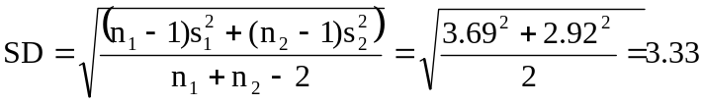
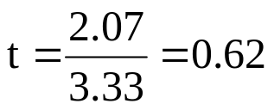
Understanding ANCOVA
Illustration To compare the effect of socioeconomic status
on children’s weight.
Age and weight among low and high socio economic status
Low Socio Economic High Socio Economic
Subject Age(X1) Weight(Y1) Age(X2) Weight(Y2)
(month) (kg) (month) (kg)
1 71 17 60 18
2 74 18 65 19
3 75 18 65 19
4 74 18 68 20
5 77 19 68 21
6 80 20 69 22
7 84 21 71 22
8 87 22 72 23
9 90 22 74 24
10 92 23 76 24
11 91 23 77 26
12 94 24 79 27
13 95 24 85 28
14 98 25 93 28
15 99 25 95 28
16 105 26 108 29
Mean 86.63 21.56 76.56 23.63
SD 10.47 2.92 12.86 3.69
Difference in weight =
Y₂-Y₁=23.63-21.56 = 2.07 kg

Slide 8


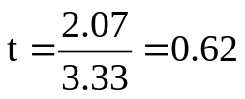
Understanding ANCOVA
__________________________________________
Mean ± SD
Low SE High SE
__________________________________________
Y:Weight(Kg) 21.56 ± 2.92 23.63±3.69
X:Age(months) 86.63 ± 10.47 76.56 ± 12.86
__________________________________________
Without considering Age
No effect of socioeconomic on weight
The difference in mean wt. 2.07 is deceptive
Low SE children have unfair advantage due to greater average age.
How to set aside the effect of age?
Use the concept of regression analysis

Slide 9










Concept of Regression in ANCOVA
Relationship is either known on the basis of earlier studies
or
It can be estimated on the basis of the data
a₁= y value when x is 0
b = rate of change of y with x
Weight
Group 1: High SE
ANOVA Assumption: slope is same in both the groups
Age
Group 2: Low SE
Direct comparison of and is not possible due to
We will adjust and for a common X value say X*
Expected difference between weights with the same value of age in two SE groups

Slide 10



Concept of Regression in ANCOVA
Y X Z
Subject Weight Age Dummy
1 17 60 0
2 18 65 0
3 18 65 0
.
.
25 95 0
26 108 0
1 18 71 1
2 19 72 1
3 19 75 1
20 76 1
.
.
15 28 100 1
16 29 105 1
Adjusted mean of Y for High SE group
$${\bar{Y}}_{1_adj}={\bar{Y}}_{1}−b({X^{∗} −\bar{X}}_{1})$$
Adjusted mean of Y for Low SE group
Low SE
Thus adjusted mean difference in two groups
High SE
How to find b ?
The model
Y= a+bX+cZ+ε
X: Age, Y = Weight
Z: Dummy variable,
0: Low SE group, 1 : High SE group
Y(weight)= 1.68 + .260 X(Age) - .551 Z

Slide 11

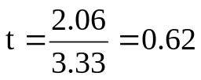


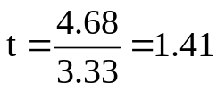
Effect of Covariate in ANCOVA
Adjusted mean difference in two groups
= (23.63 - 21.56) - .26(76.56 - 86.63)
= 2.06 + .26 × 10.07
= 4.68
Unadjusted term
Adjusted term
Without adjustment
After adjustment
Let’s see whether this difference is significant
Increase in t value
Conclusion If you eliminate the effect of confounding variable effect may be visible.

Slide 12
ANCOVA with SPSS
-An Illustration
Data on resting pulse rate(beat/min.) before and after the four week treatment
_____________________________________________
Pranayama
S.N. Bhastrica Ujjai Bhast × Ujjai
_____________________________________________
Pre Post Pre Post Pre Post
1 70 68 69 67 71 71
2 73 72 72 71 72 73
3 69 67 70 70 80 79
4 71 70 68 66 78 78
5 80 78 82 81 69 70
6 69 69 68 67 68 66
7 78 77 72 69 75 73
8 73 73 76 74 73 74
9 68 67 69 68 79 78
10 80 77 80 78 68 68
11 74 73 72 72 74 75
12 69 68 75 74 87 85
13 67 67 67 67 69 68
14 72 71 74 73 73 73
15 70 69 76 75 82 81
_____________________________________________
Objective: To compare the effect of different pranayama on resting pulse rate
Hypotheses needs to be tested
Against H₁: At least one group mean differs
$$H_{0}:μ_{Adj_Po_Bastrika}=μ_{Adj_Po_Ujjai}=μ_{Adj_Po_\text{Bast}\text{. }\text{x} \text{Ujjai}}$$

Slide 13
Layout Design in ANCOVA
Testing protocol
Factor 1: Time
Bhastrica
Ujjai
Bha××Ujj
Pre Post
Pre Post
Pre Post
S1
S2
.
.
.
S14
S15
S1
S2
.
.
.
S14
S15
S16
S17
.
.
.
S29
S30
S16
S17
.
.
.
S29
S30
S31
S32
.
.
.
S44
S45
S31
S32
.
.
.
S44
S45
Subjects
If F-test is significant, then a pair wise comparison of means is done by using the
Bonferroni correction.
The SPSS output provides the p-value for the difference of each pair of group means.

Slide 14
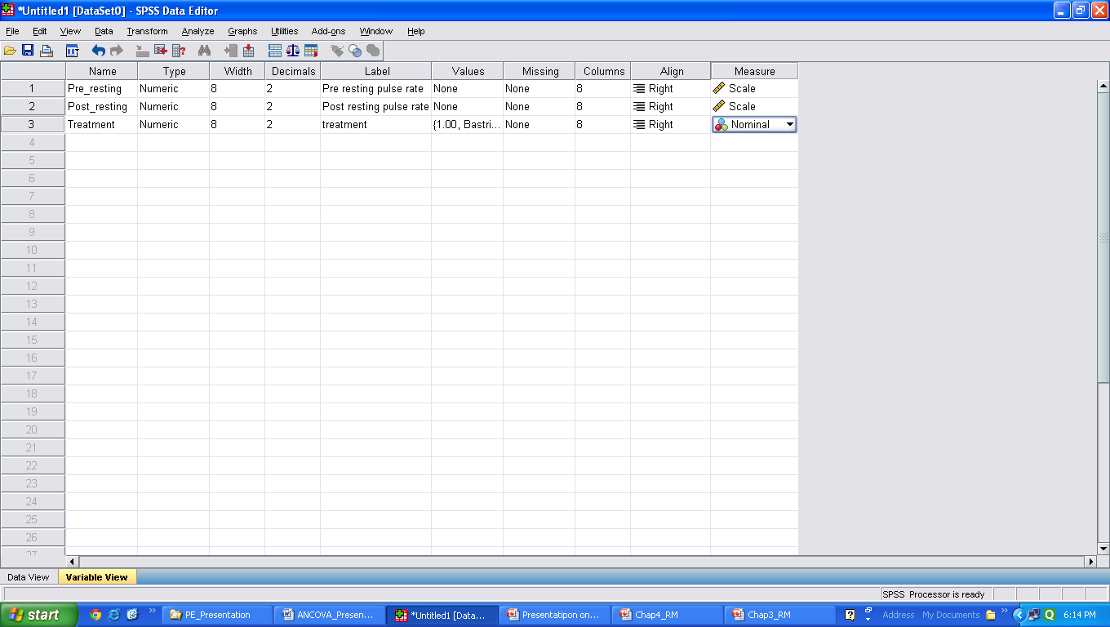
Defining Variables
Figure 1. Defining variables along with their characteristics

Slide 15
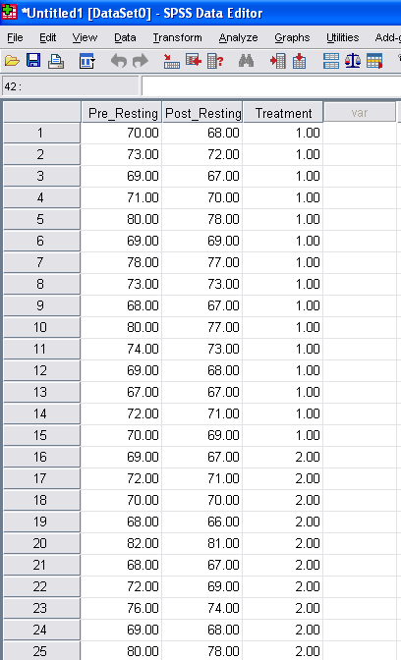
Data Feeding Format
Figure 2. Data file of resting pulse rate for analysis of covariance

Slide 16
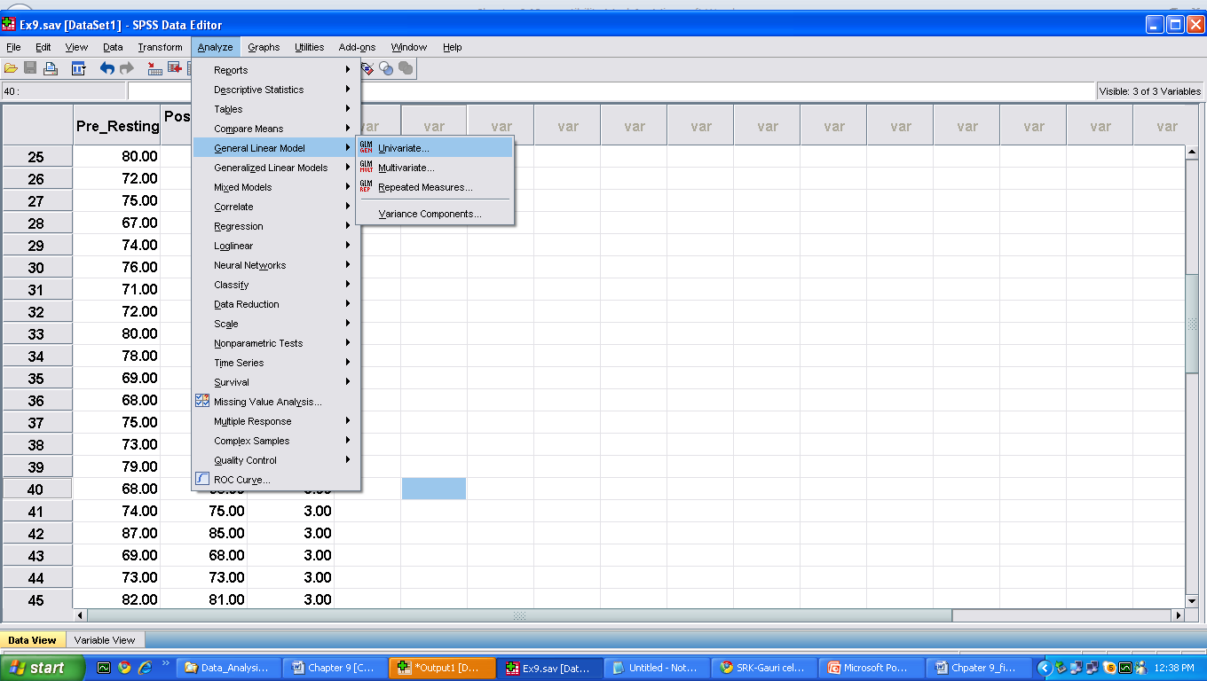
Initiating Commands in SPSS for ANCOVA
Analyze General Linear Model Univariate
Figure 3. Command sequence for analysis of covariance

Slide 17
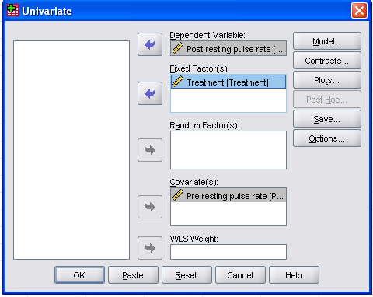
Selecting Different Variables
Bring dependent variable from left panel to this location
Bring independent variable from left panel to this location
Bring covariate from left panel to this location
Click on OK
Figure 4. Selection of variables for ANCOVA

Slide 18
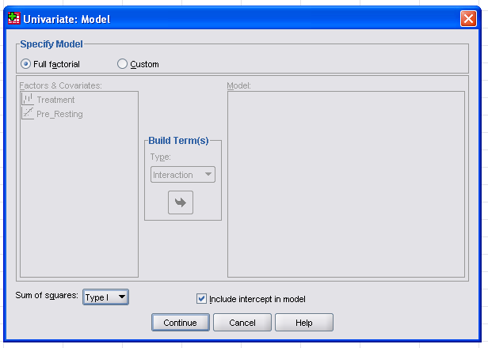
Selecting Model for ANCOVA Analysis
Select radio button for full factorial
Choose the option “Type I” for sum of squares
Figure 5. Option for selecting model
Click on Continue

Slide 19
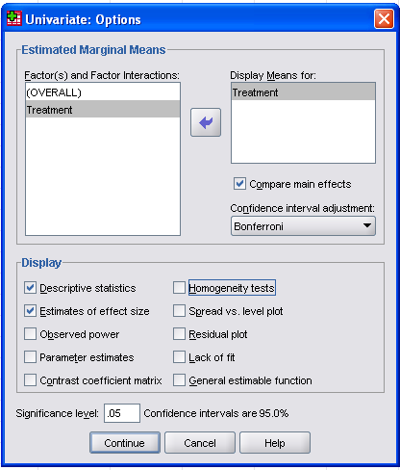
Layout Design in ANCOVA
Bring the independent variable ‘Treatment’ at this location from the left panel
Check this option for comparing main effects
Check these options
Figure 6. Selecting options for various outputs in ANCOVA

Slide 20
SPSS Outputs and Interpretation
Descriptive statistics
Adjusted Mean and SD of post treatment data
F table for between-subjects effects
ANCOVA table
Pair wise comparison of means
Pairwise comparisons graphically

Slide 21
Outputs of ANCOVA in SPSS
Output 1: Descriptive Statistics
Table 1. Mean and standard deviation of different
groups measured in post-treatment.
__________________________________
Treatment Mean SD N
__________________________________
Bashtrika 71.0667 3.82598 15
Ujjai 71.4667 4.40562 15
Bast. x Ujjai 74.1333 5.28970 15
Total 72.2222 4.65095 45
__________________________________

Slide 22
Layout Design in ANCOVA
Output 2: Adjusted Mean and SD of post treatment data
Table 2. Adjusted mean and standard deviation of different groups measured in post treatment groups.
_____________________________________________________
95% Confidence Interval
Treatment Mean SD Lower Bound Upper Bound
_____________________________________________________
Bashtrika 71.932ª .232 71.464 72.401
Ujjai 71.900ª .231 71.434 72.365
Bast. x Ujjai 72.835ª .234 72.363 73.307
_____________________________________________________
Covariates appearing in the model are evaluated at the following
values: Pre treatment score of resting pulse rate = 73.1333.

Slide 23
Layout Design in ANCOVA
Output 3: F table for between-subjects effects
Table 3. Tests ‘between-subjects’ effects
Dependent variable: Post-testing score of resting pulse rate
______________________________________________________________________________
Type I Sum Partial
Source of Squares df Mean Square F Sig. Eta Square
______________________________________________________________________________
Corrected Model 919.146a 3 306.382 384.954 .000 .966
Intercept 234722.222 1 234722.222 2.949E5 .000 1.000
Pre_Resting 911.057 1 911.057 1.145E3 .000 .965
Treatment 8.089 2 4.045 5.082 .011 .199
Error 32.632 41 .796
Total 235674.000 45
Corrected Total 951.778 44
____________________________________________________________________________
a. R Squared = .966 (Adjusted R Squared = .963)

Slide 24
Layout Design in ANCOVA
Output 4: ANCOVA Table
Table 4. ANCOVA table for the post test data on resting pulse rate
_______________________________________________________________________
Type I Sum Partial
Source of Squares df Mean Square F Sig. Eta Square
_______________________________________________________________________
Pre_Resting 911.057 1 911.057 1.145E3 .000 .965
Treatment 8.089 2 4.045 5.082 .011 .199
Error 32.632 41 .796
_______________________________________________________________________
Corrected Total 951.778 44
_______________________________________________________________________
Result: F for the adjusted group means is significant(p<.011)
What Next?
Post hoc test shall be used for pair-wise comparison of means.

Slide 25
Layout Design in ANCOVA
Output 5: Pairwise comparisons
Table 5. Pair wise comparisons
Dependent Variable: Post-treatment resting pulse rate
____________________________________________________________________________
(I) Treatment (J) Treatment Mean Diff. 95% CI for Differenceª
Group Group (I-J) SE Sig.ª Lower Bound Upper Bound
____________________________________________________________________________
Bastrika Ujjai .033 .326 1.000 -.781 .847
Bast. x Ujjai -.902* .333 .029 -1.732 -.072
____________________________________________________________________________
Ujjai Bastrika -.033 .326 1.000 -.847 .781
Bast. x Ujjai -.935* .330 .021 -1.759 -.111
____________________________________________________________________________
Bast. x Ujjai Bastrika .902* .333 .029 .072 1.732
Ujjai .935* .330 .021 .111 1.759
____________________________________________________________________________
Based on estimated marginal means
a. Adjustment for multiple comparisons: Bonferroni.
*. The mean difference is significant at the .05 level.

Slide 26
Layout Design in ANCOVA
Output 6: Pairwise comparisons graphically
Table 6. Pair wise comparisons of post treatment
means of the data on resting pulse rate
__________________________________________
Bastrica×Ujjai Bastrika Ujjai
Group Group Group
__________________________________________
72.835 71.932 71.900
__________________________________________
“ “ represents no significant difference at 5% level.
Inference
The combination of Bastrica and Ujjai treatments was not effective compared to either Bastrica or Ujjai treatment alone in reducing the resting pulse rate.
Bastrica and Ujjai were equally effective.

